Slide 1
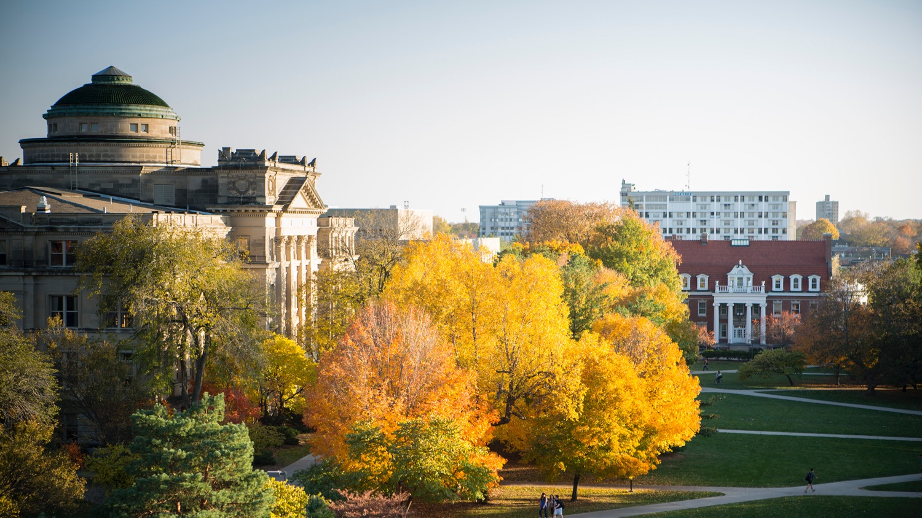
DS401 - Data Science Capstone
Analyzing service call data in Cerro Gordo County, IA

Slide 2
Predict-Align-Prevent Model to Improve Health and Safety
Data Science Capstone
Team 1: Community Safety
Sponsor: Shawn Dorius
Instructor: Adisak Sukul
Pramit Vyas, Neha Maddali, Alexis Maldonado

Slide 3
Project Overview
PREDICT WHEN AND WHERE
ALIGN RESOURCES
PREVENT THESE INCIDENTS
Notes:
PREDICT WHEN AND WHERE SUBSTANCE RELATED INCIDENTS OCCUR. ENGAGE WITH LOCAL DECISION MAKERS TO ALIGN RESOURCES AND INTERVENTIONS TO PREVENT THESE INCIDENTS.

Slide 4
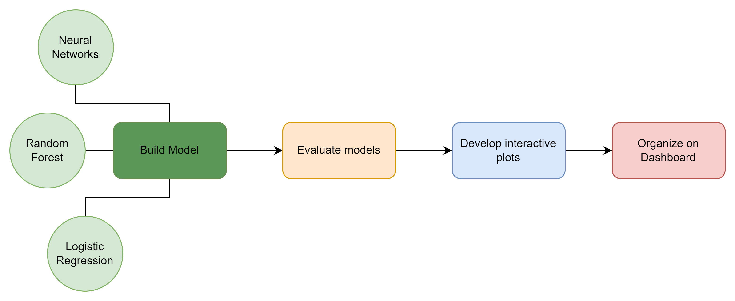
Project Overview - Workflow

Slide 5
Data Overview
Cerro Gordo County call for service data from 2018-2023
Important variables
cfs_type and category
Time elements
Geospatial elements

Slide 6
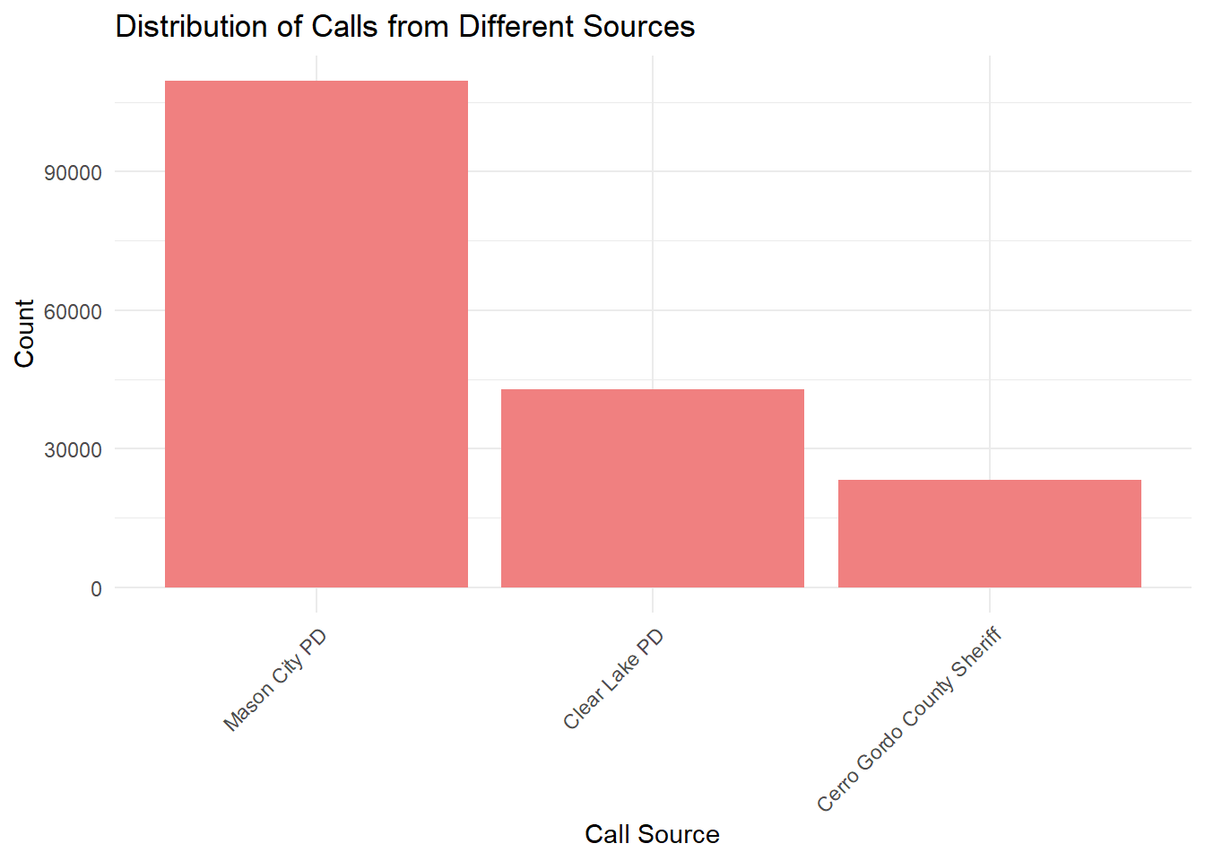
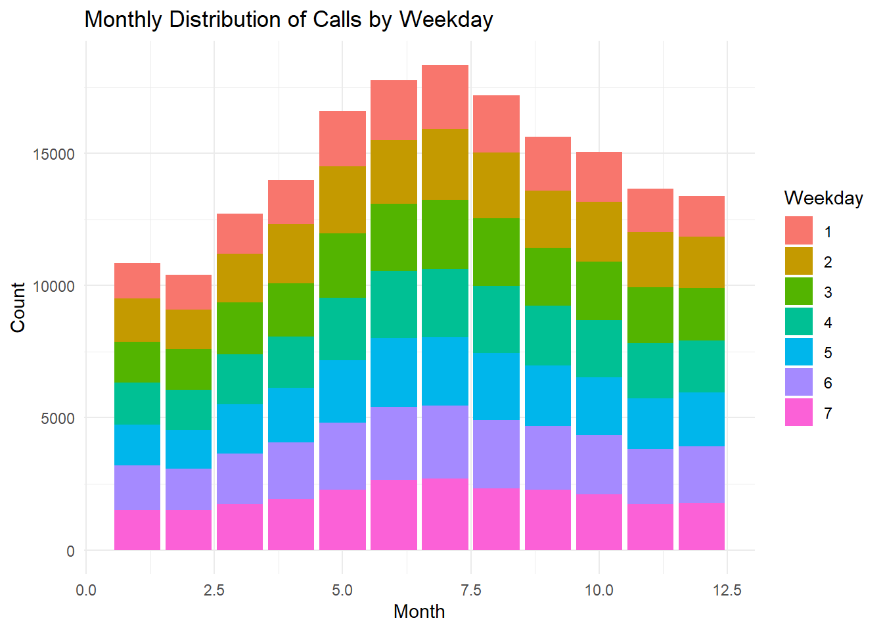
Exploratory Data Analysis – Holistic

Slide 7
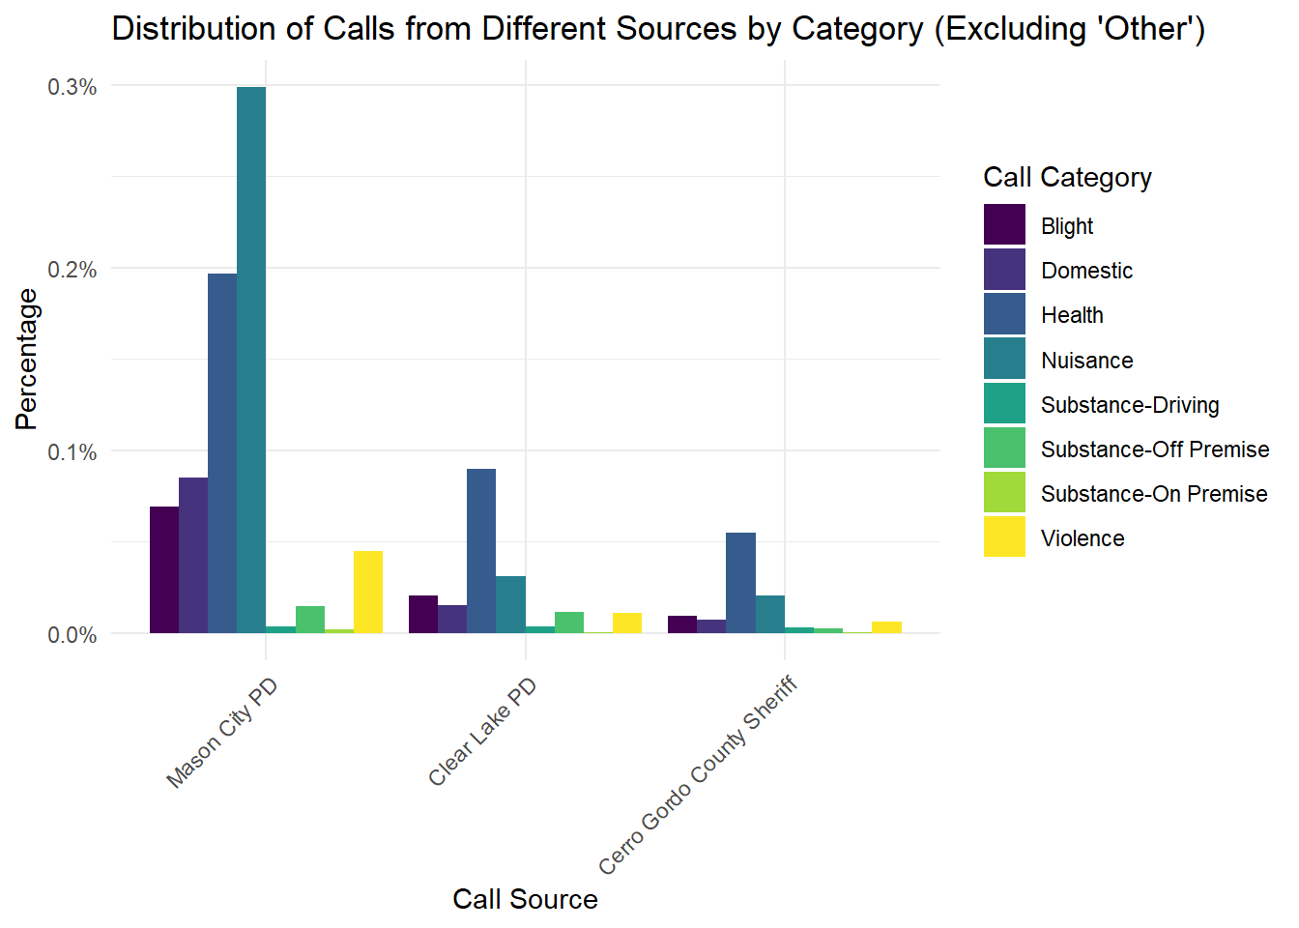
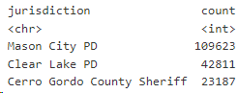
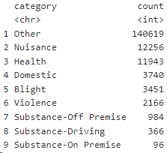
Exploratory Data Analysis - Holistic

Slide 8
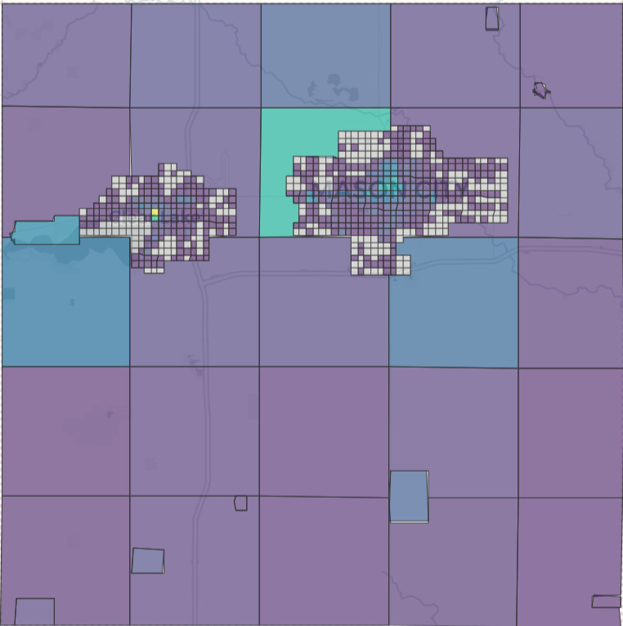
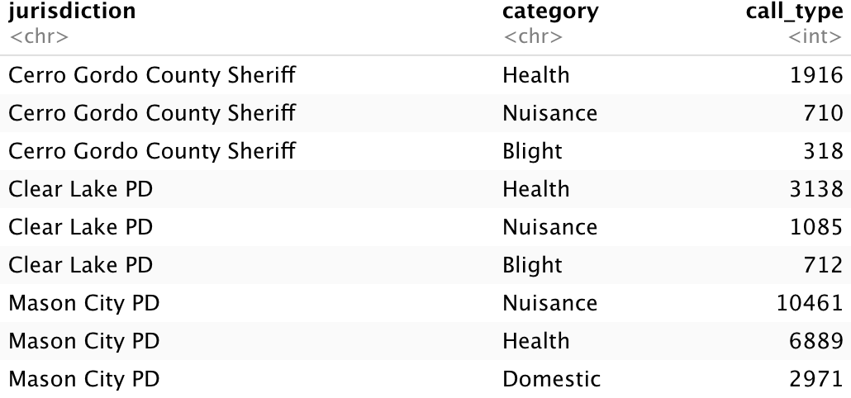
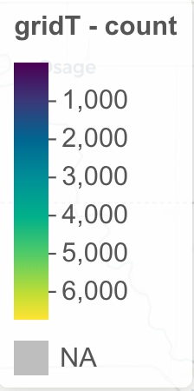
Exploratory Data Analysis - Holistic

Slide 9
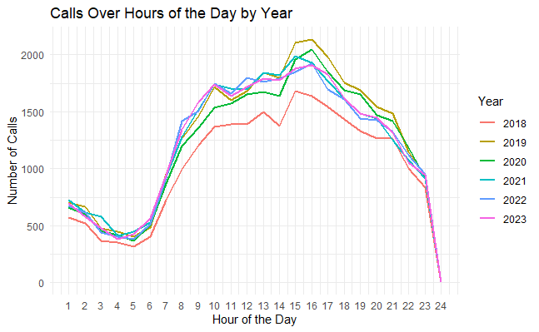
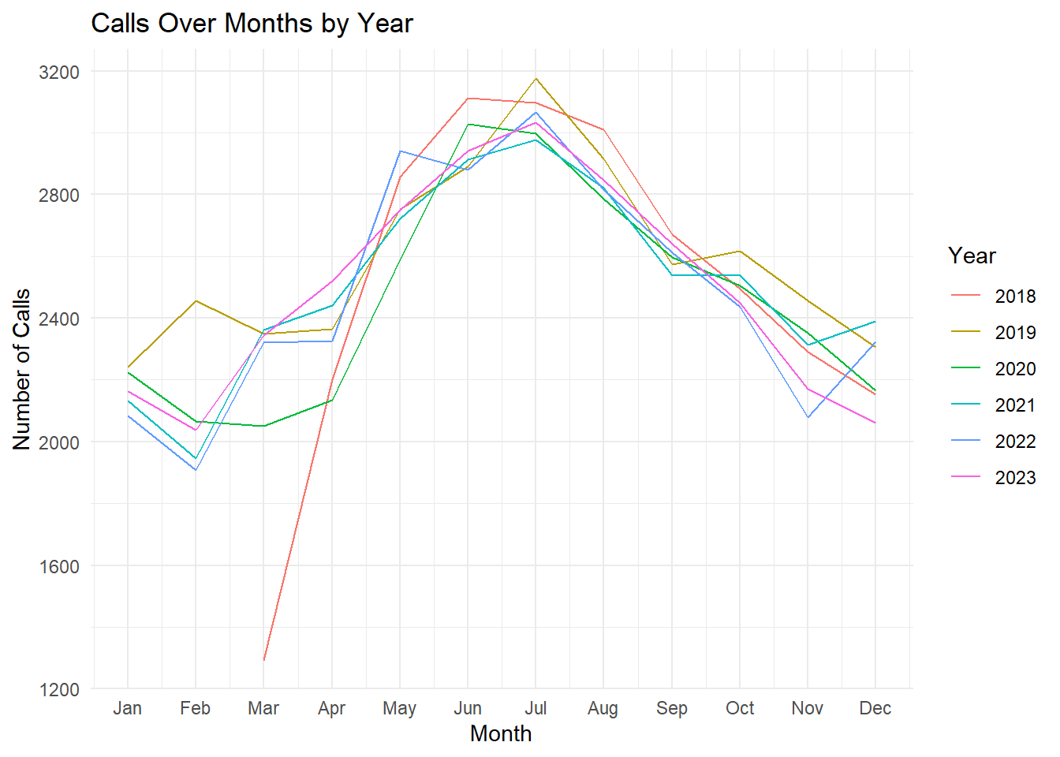
Exploratory Data Analysis - Holistic

Slide 10
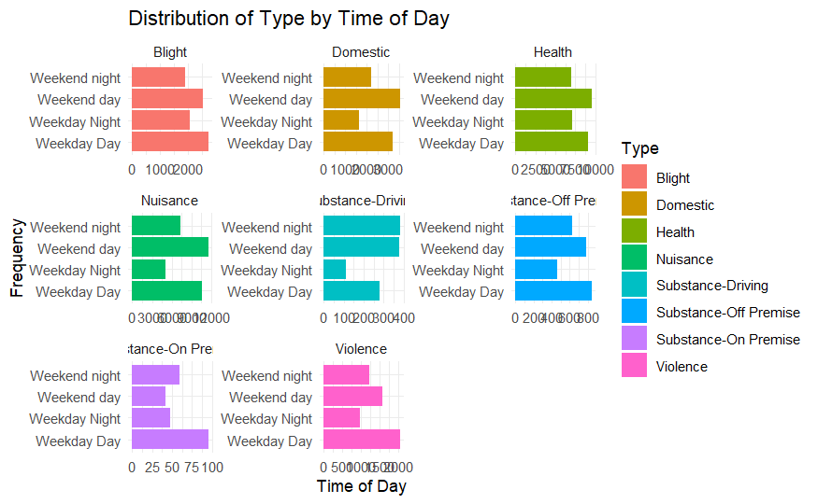
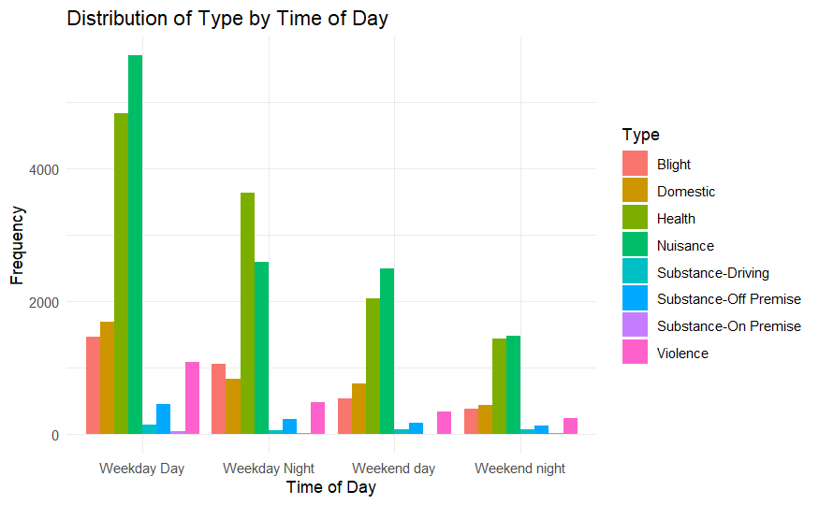
Exploratory Data Analysis - Holistic

Slide 11
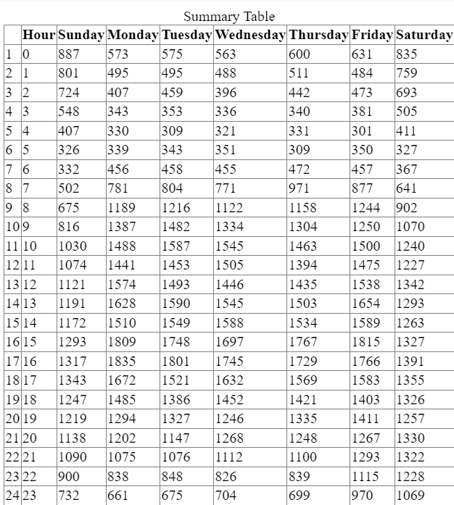
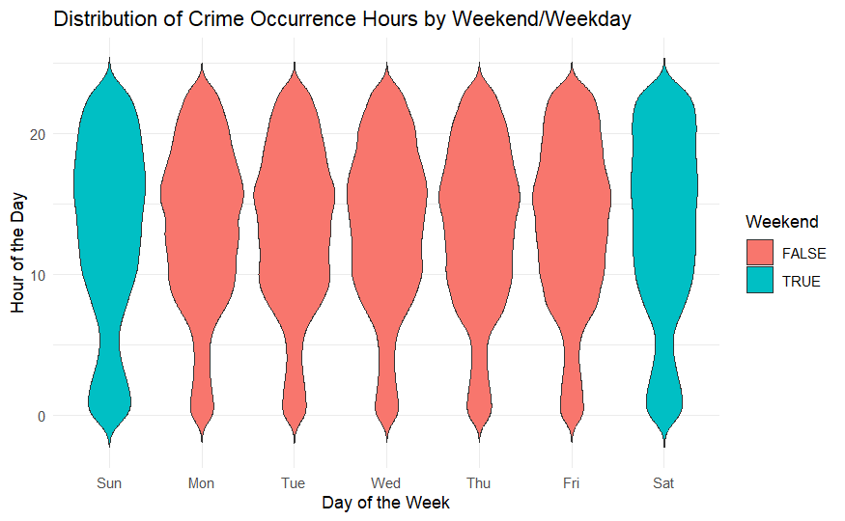
Exploratory Data Analysis - Holistic

Slide 12
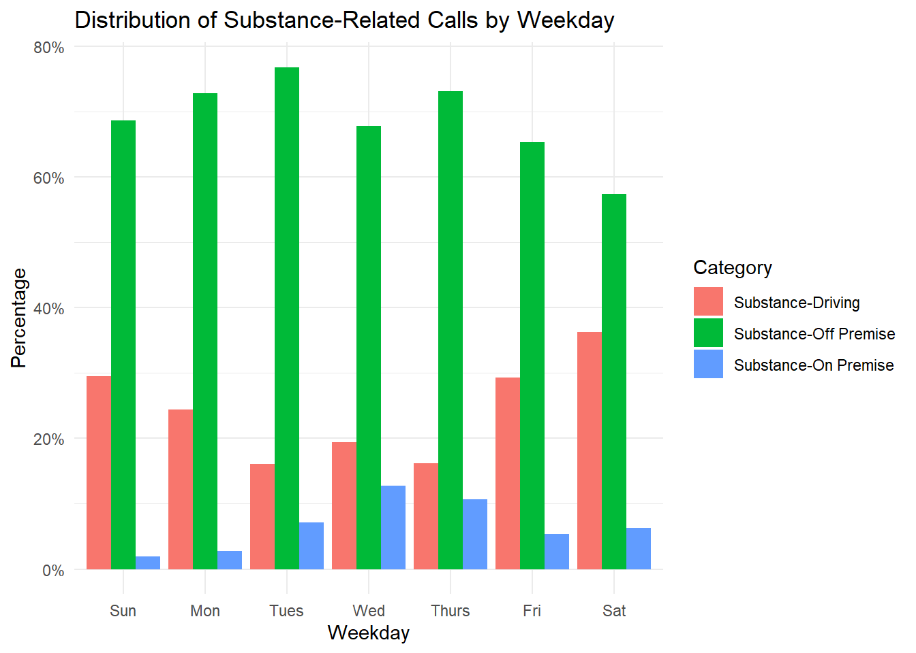
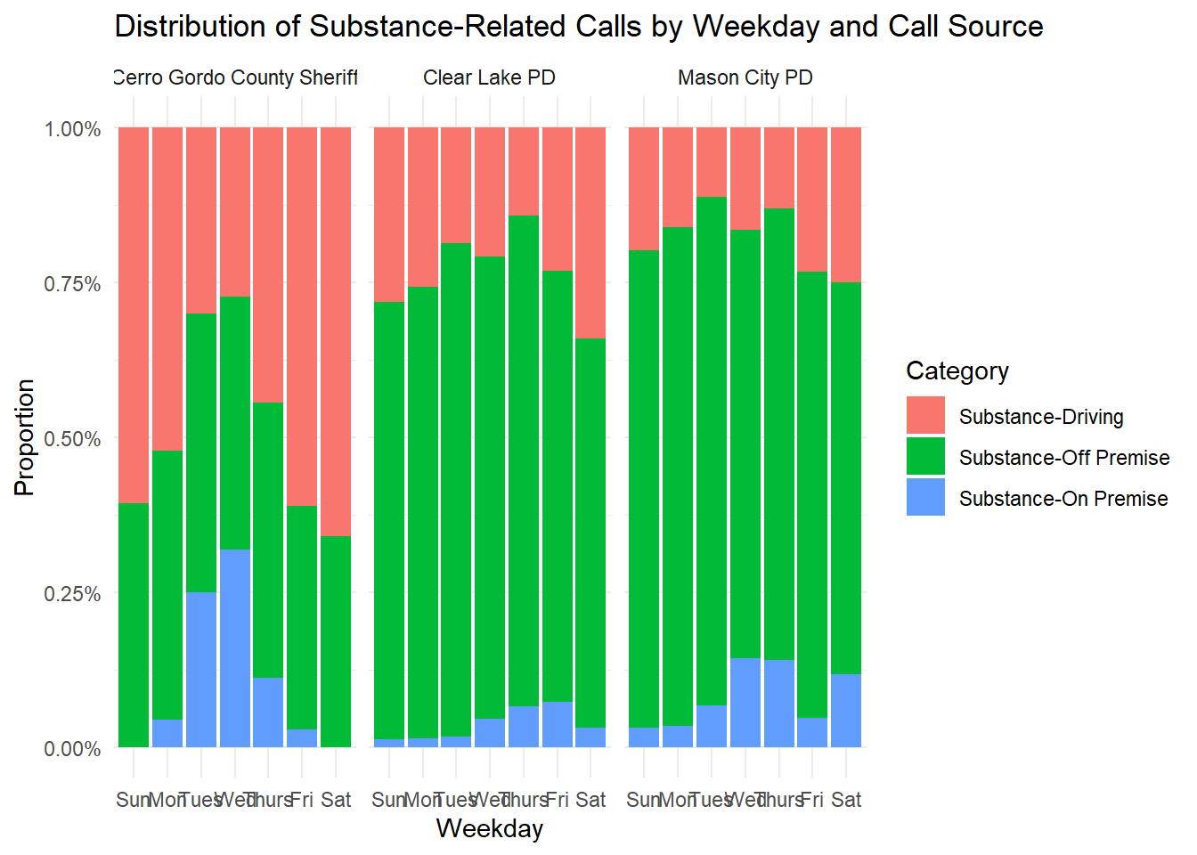
Exploratory Data Analysis – Substance Related

Slide 13
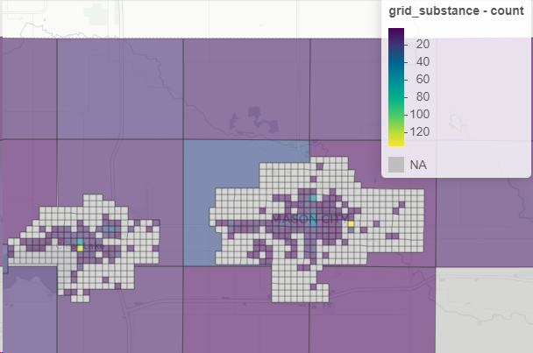
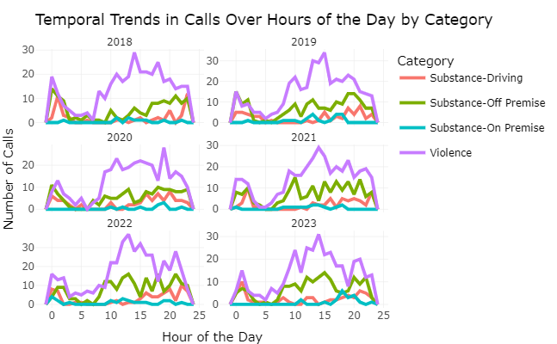
Exploratory Data Analysis - Substance Related

Slide 14
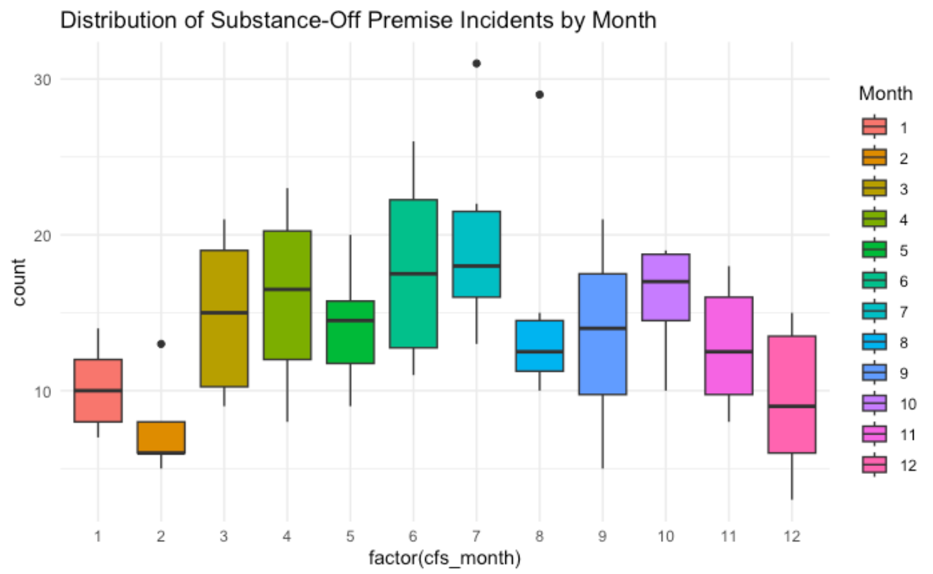
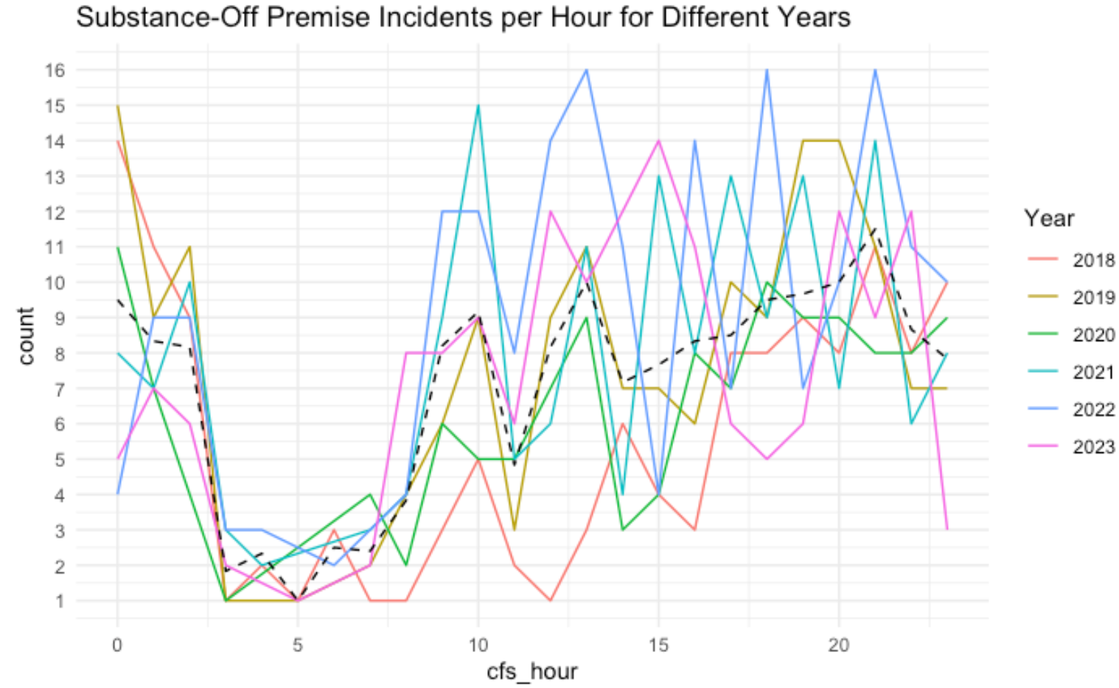
Exploratory Data Analysis - Substance Related

Slide 15
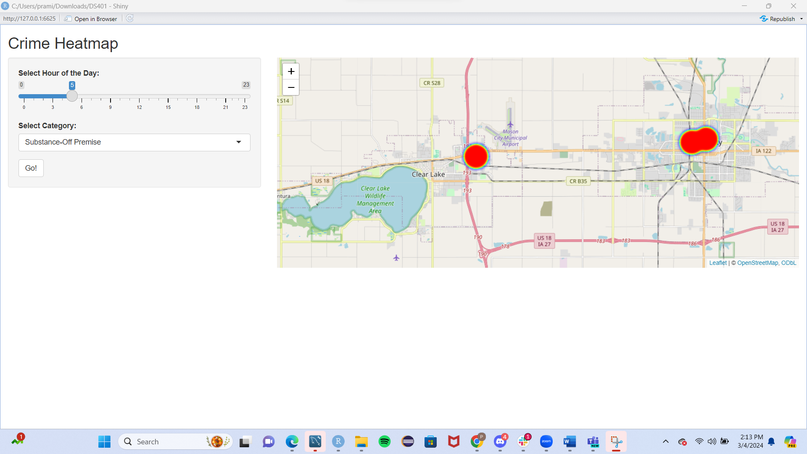
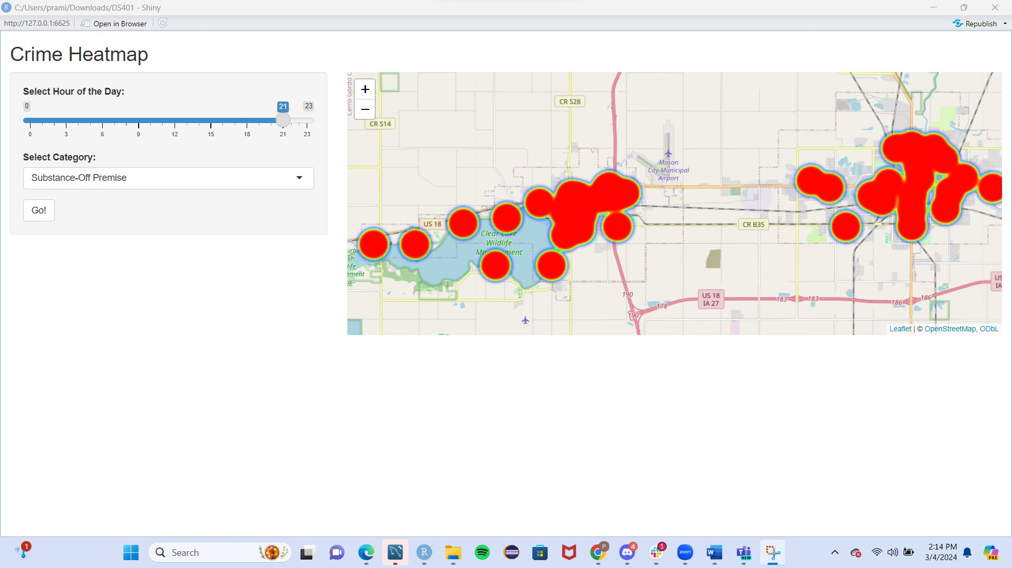
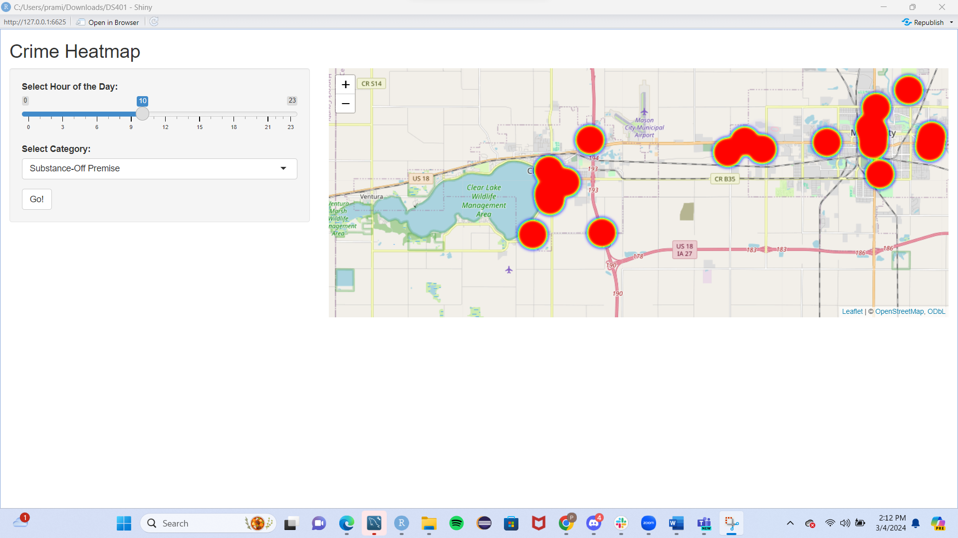
Exploratory Data Analysis - Substance Related

Slide 16
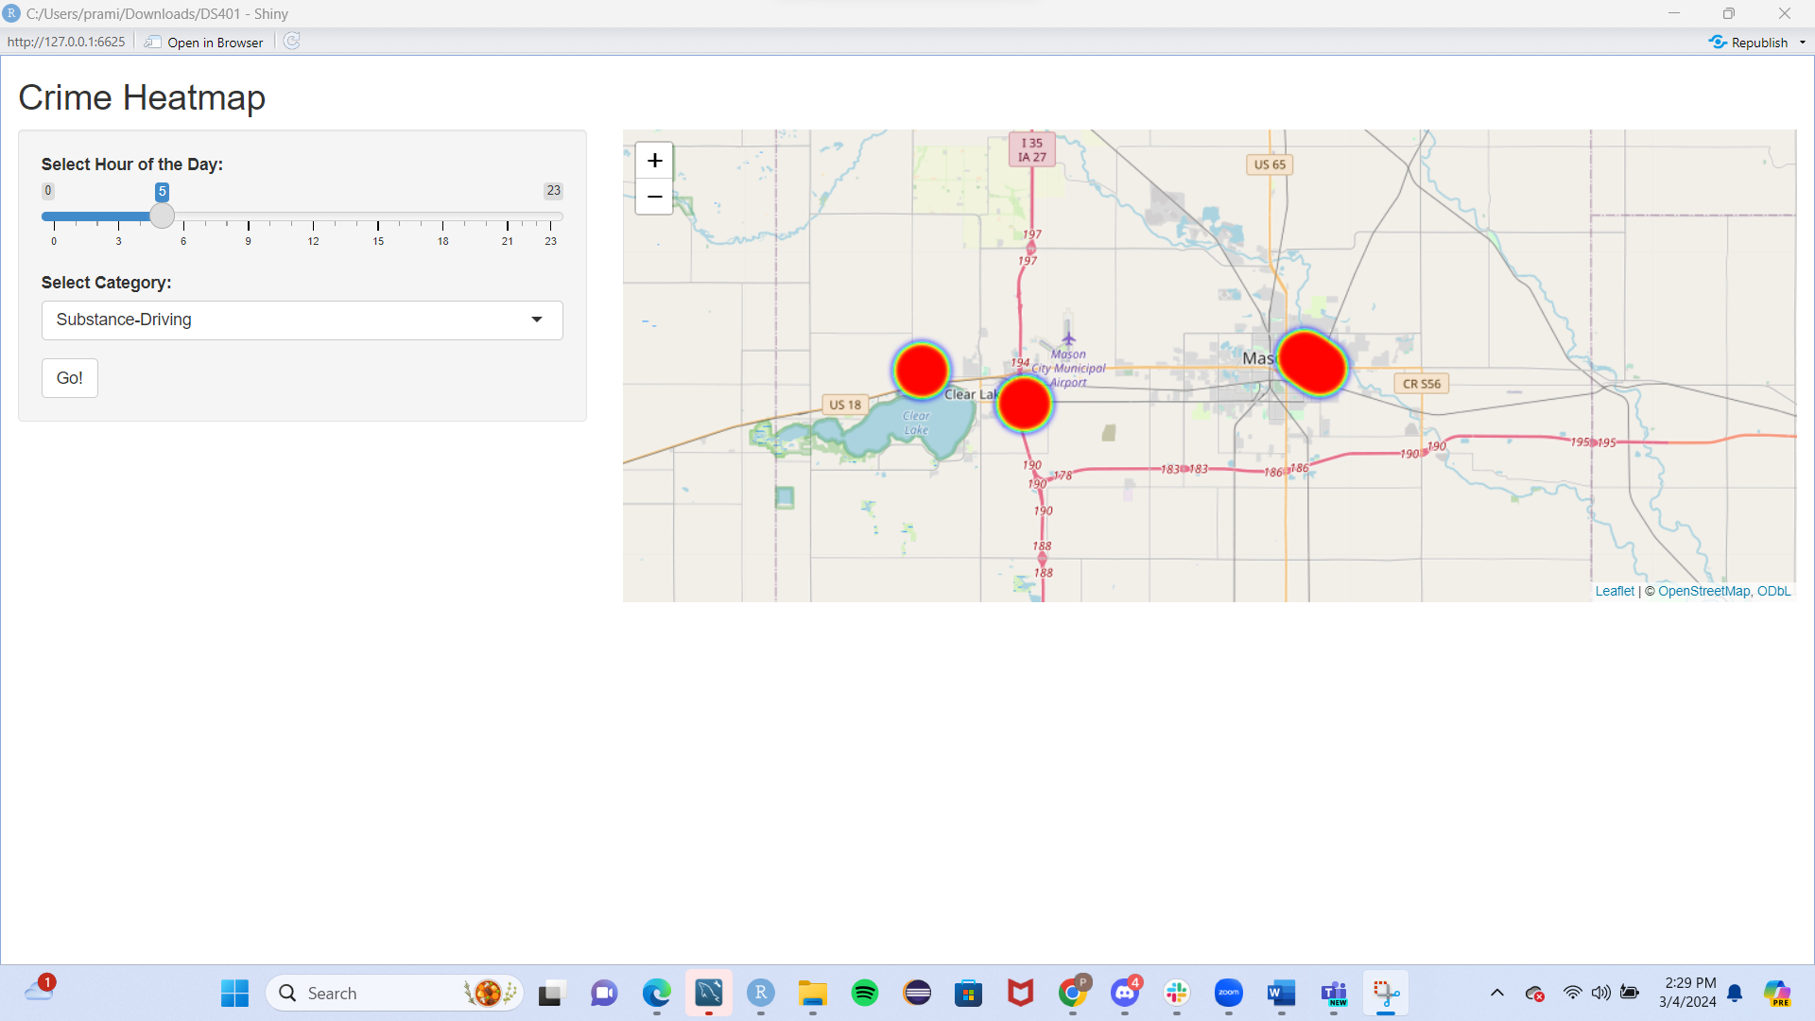
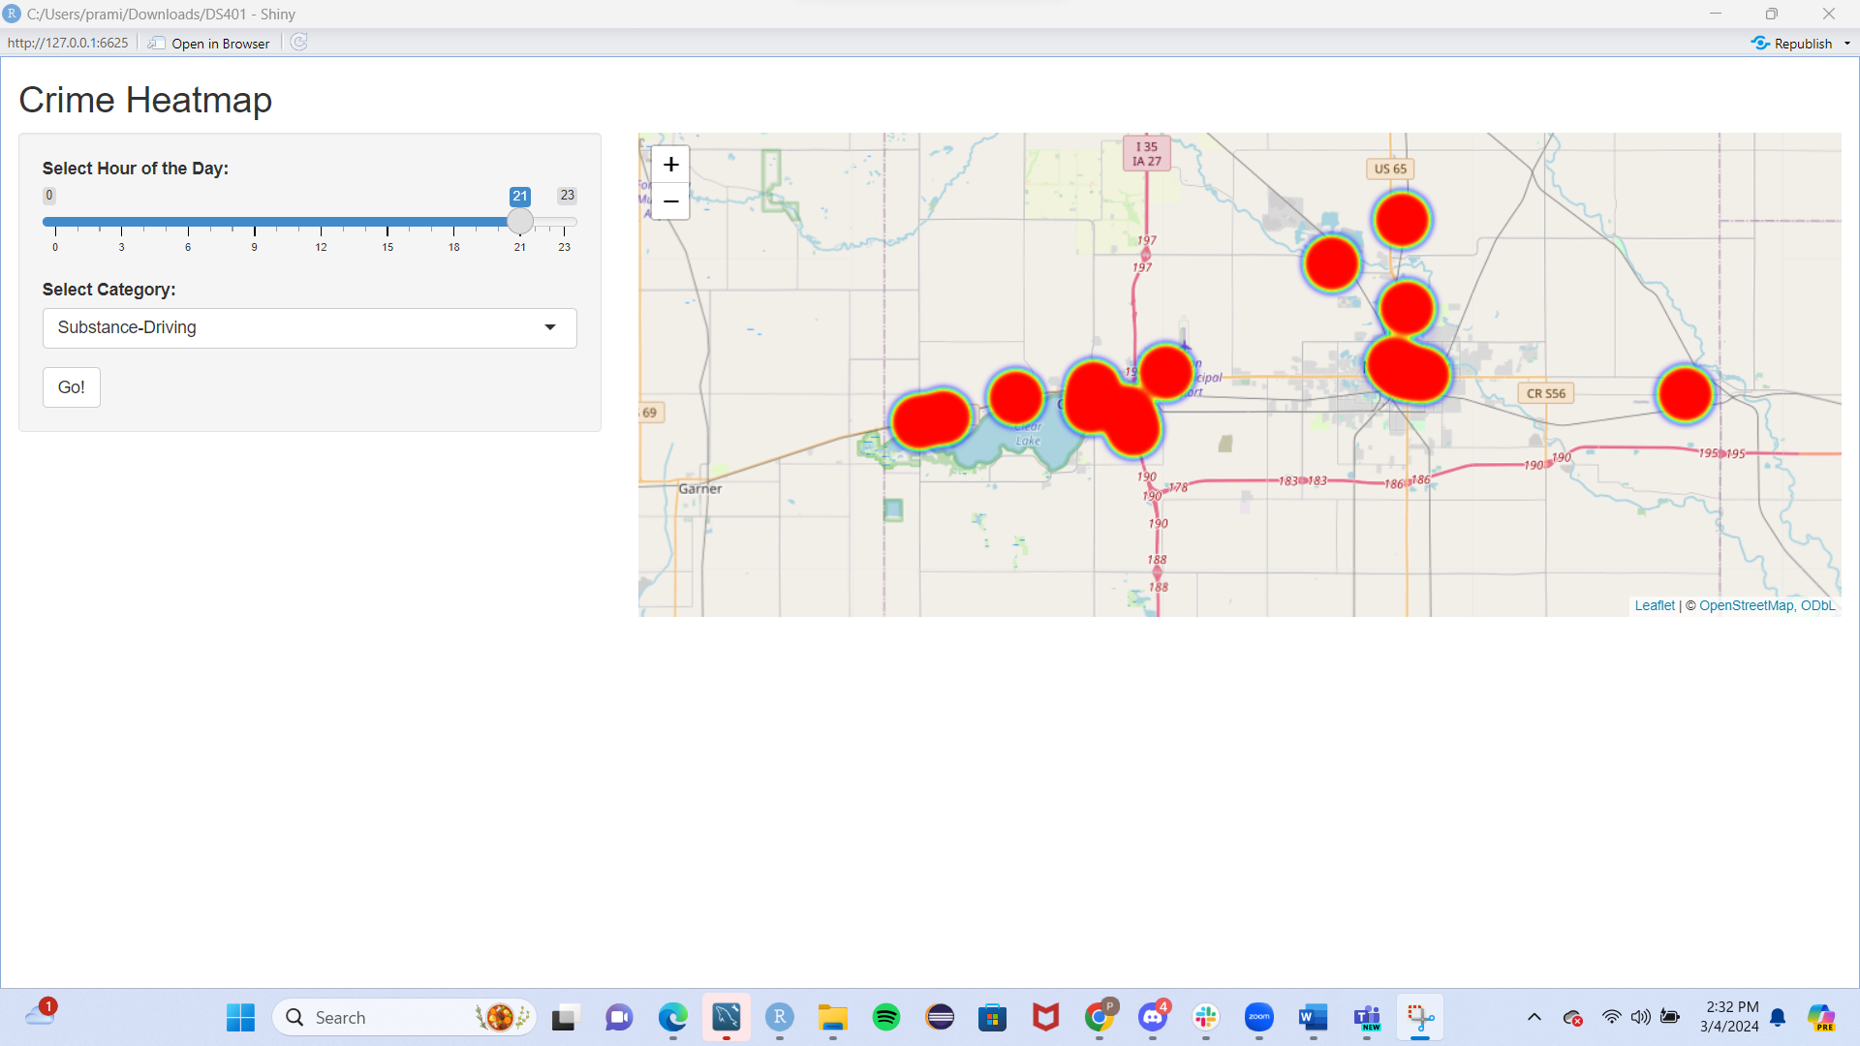
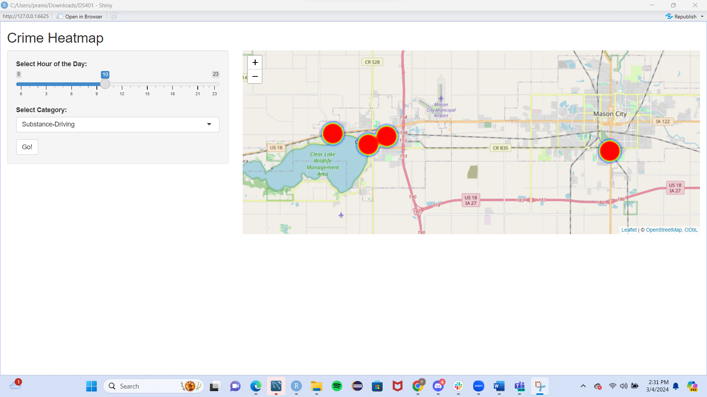
Exploratory Data Analysis - Substance Related

Slide 17
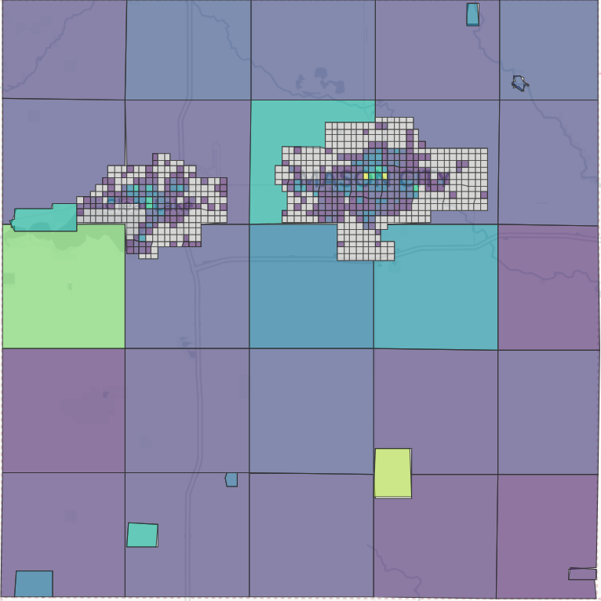
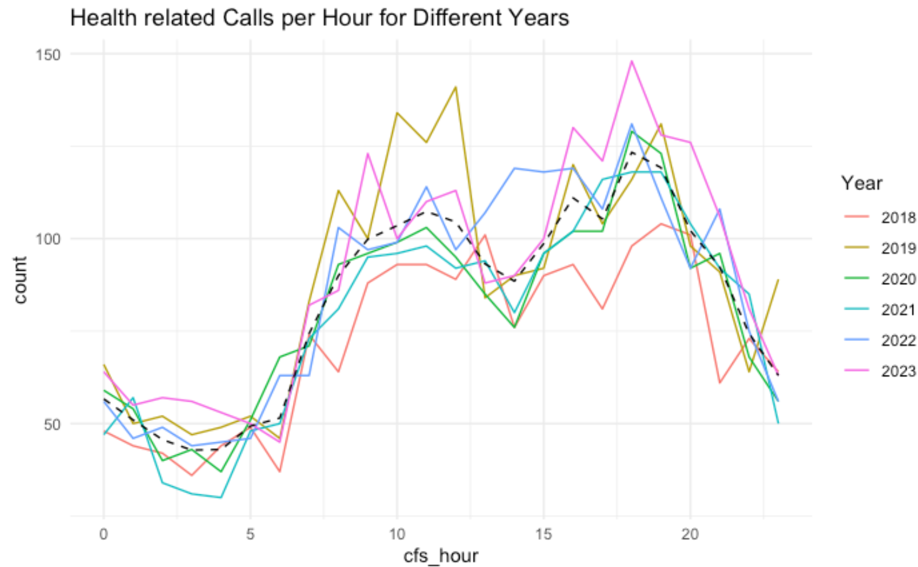
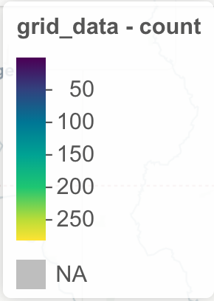
Exploratory Data Analysis – Other Insights

Slide 18
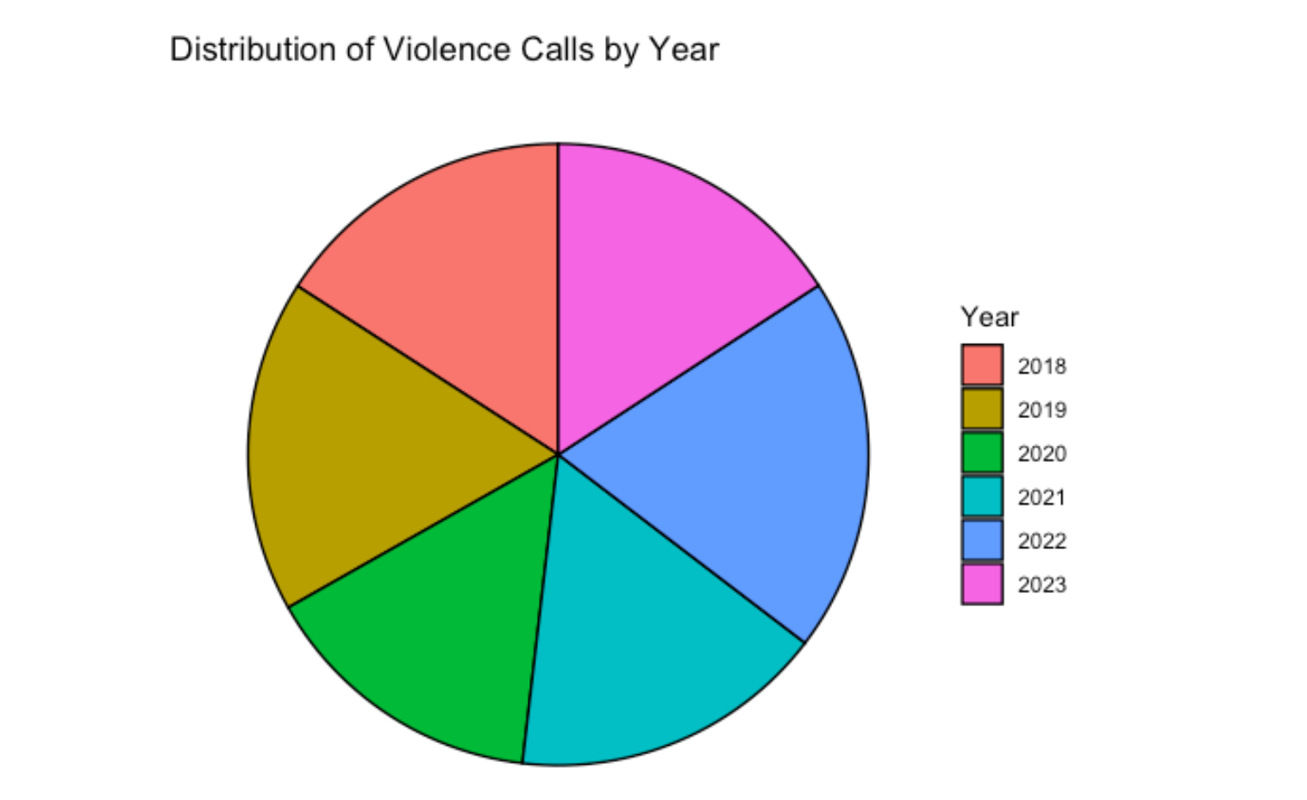
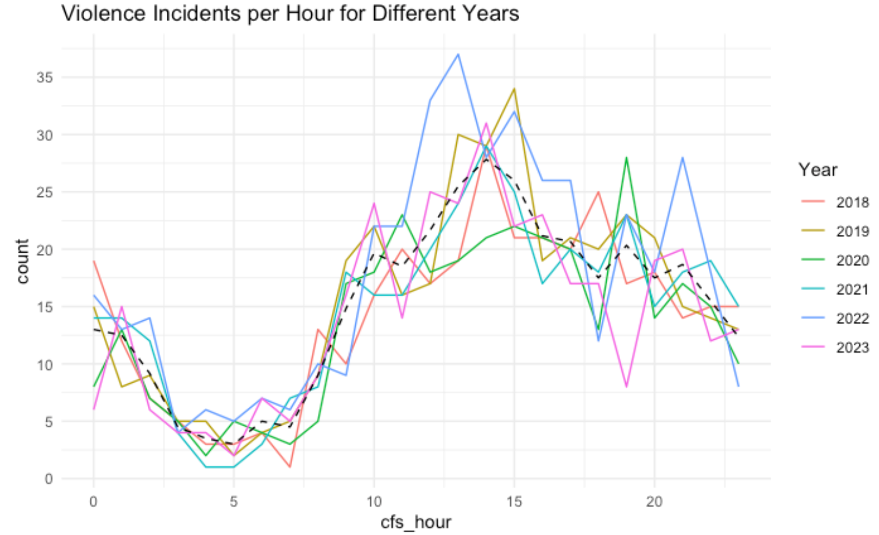
Exploratory Data Analysis – Other Insights

Slide 19
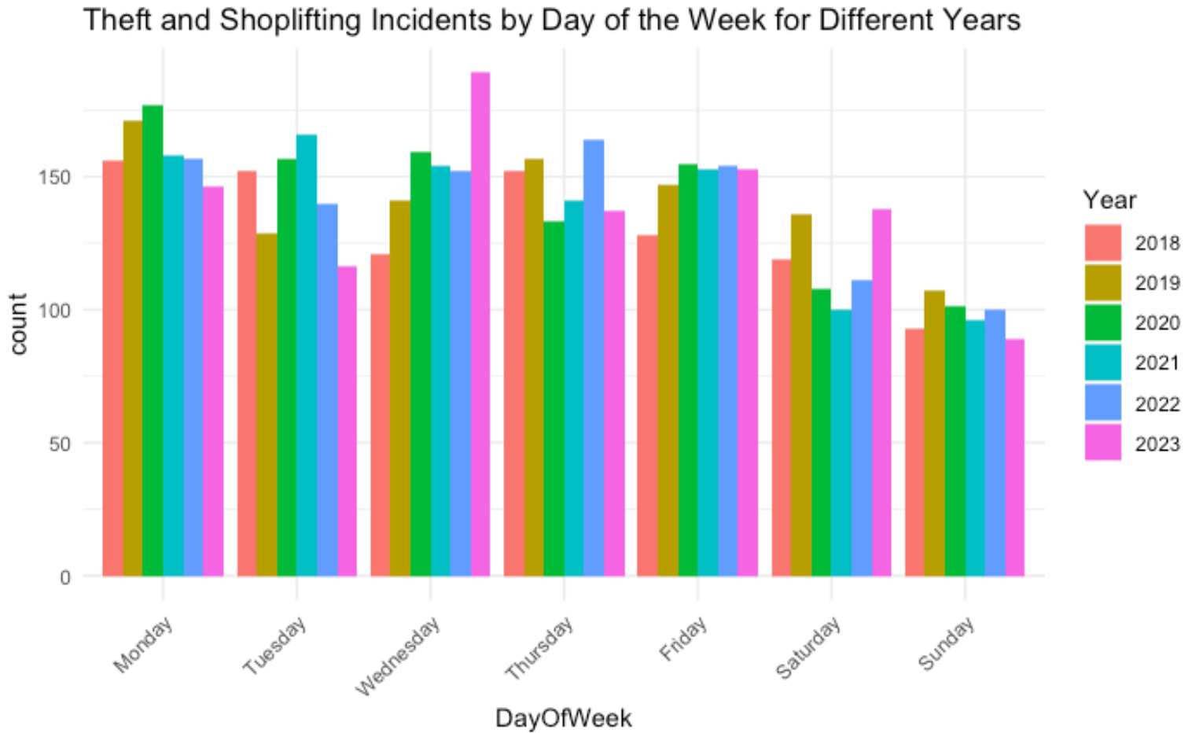
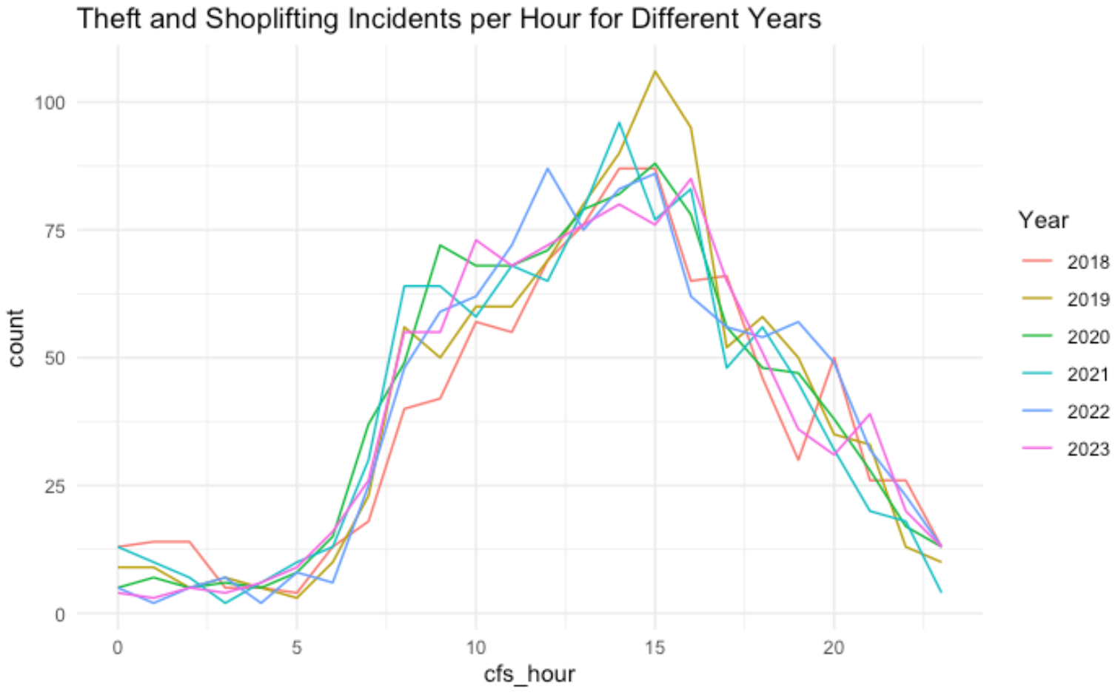
Exploratory Data Analysis – Other Insights

Slide 20
Logistic Regression
THE USE OF PREDICTIVE ANALYSIS INSPATIOTEMPORAL CRIME FORECASTING: BUILDING AND TESTING A MODEL IN A URBAN CONTEXT
BURGLARY CRIME ANALYSIS USING LOGISTIC REGRESSION
ESTIMATING THE PROBABILTY OF LOCAL CRIME CLUSTERS: THE IMPART OF IMMEDIATE SPATIAL NEIGHBORS
A BAYESAIN AORITDTIC LOGISTIC REGRESSION TO MODEL SPATIO-TEMPERAL CRIME RISK UNDER THE PRESNES OF INTERVAL-CENSORED TIME EVENTS
Train multiple Logistic Regressions to be able to make predictions with high levels of confidence
Notes:
In random forest model, a subset of data points and a subset of features are selected for constructing each decision tree. Simply put, n random records and m features are taken from the data set having k number of records. Individual decision trees are constructed for each sample. Each decision tree will generate an output. Final output is considered based on Majority Voting for classification or Averaging for regression.

Slide 21
Random Forests
INCORPORATING SPACE AND TIME INTO RANDOM FOREST MODELS FOR ANALYZING GEOSPATIAL PATTERNS OF DRUG-RELATED CRIME INCIDENTS IN A MAJOR U.S. METROPOLITAN AREA
PREDICTING CRIME USING TIME AND LOCATION DATA
MINING 911 CALLS IN NEW YORK CITY: TEMPORAL PATTERNS, DETECTION AND FORECASTING
CRIME PREDICTION USING SPATIO TEMPORAL DATA
Build many DECISION TREES during training and COMBINE their predictions to achieve robust and accurate result
Notes:
In random forest model, a subset of data points and a subset of features are selected for constructing each decision tree. Simply put, n random records and m features are taken from the data set having k number of records. Individual decision trees are constructed for each sample. Each decision tree will generate an output. Final output is considered based on Majority Voting for classification or Averaging for regression.

Slide 22
Neural Networks
Artificial Neural Networks and Crime Mapping in Pittsburgh
Forecasting Crime with Deep Learning in Chicago and Portland using Feed-Forward Networks and a combination of CNN and RNN
Automatic Crime Report Classification through a weightless Neural Network
Crime Hotspot Forecasting: A recurrent model with spatia and temporal information
Use a non-linear activation function to connect neurons through hidden layers to make predictions
Notes:
In random forest model, a subset of data points and a subset of features are selected for constructing each decision tree. Simply put, n random records and m features are taken from the data set having k number of records. Individual decision trees are constructed for each sample. Each decision tree will generate an output. Final output is considered based on Majority Voting for classification or Averaging for regression.

Slide 23
Insert background photo in gray area
“This area is meant to be used for a quote/information of emphasis, preferably no more than two full length sentences.” – Quote Reference Here

Slide 24
Contact Us
Pramit Vyas
Pvvyas@iastate.edu
(515)-443-5484
Alexis Maldonado
ahm@iastate.edu
(319)-202-8952
Neha Maddali
nmaddali@iastate.edu
Notes:
New names

